Slide 1
ABC tDCS Device
Team: Donghyun (David) Seo, Carim-Sanni Sobur, Eric Luu, Radhanath Purakait and Shalih Miah
Sponsor: Dr. Marom Bikson
TA: Jack Twiddy, Evan Azoulay
Faculty Mentor: Alessandra Carriero

Slide 2
Introduction

Slide 3
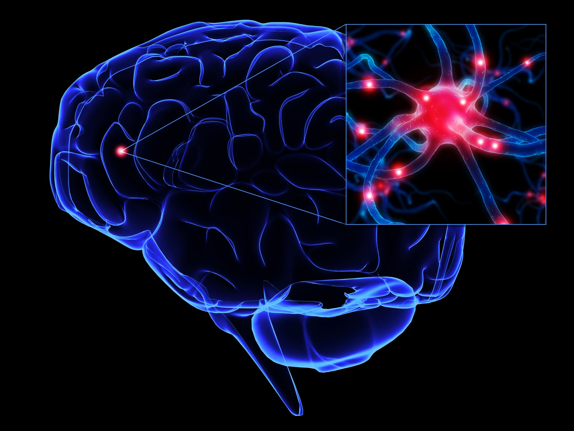
About The Brain
Comprised of network of nerve cells known as neurons [1].
Communicate to each other using tiny electrical, and chemical impulses [1].
Can be stimulated by an electrical current to facilitate the depolarization or hyperpolarization.
https://psychmuseum.uwgb.org/neuro/neurons/
[1] Churchland, Patricia Smith. MIT press, 1989.
Notes:
Shalih

Slide 4
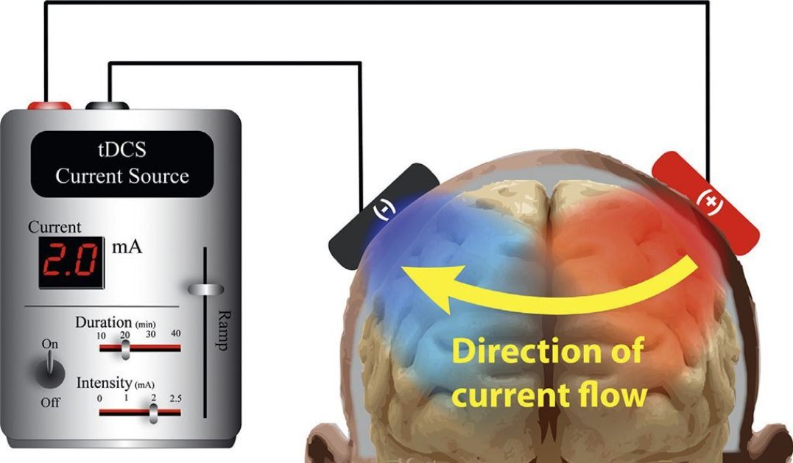
What is tDCS?
Form of neurostimulation where low levels of constant current is applied to the brain.
tDCS can strengthen or weaken the signals between neurons also known as synaptic plasticity [1].
https://caputron.com/pages/what-is-tdcs
[1] Reinhart, Robert MG, et al. Attention, Perception, & Psychophysics 79.1 (2017): 3-23.
Notes:
Shalih

Slide 5
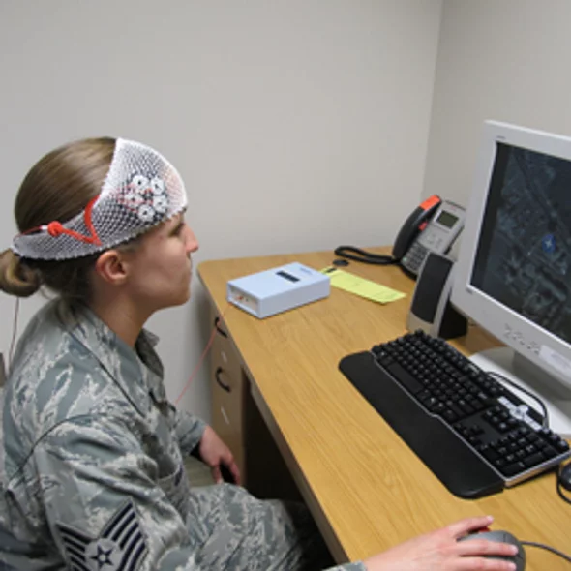
Who uses tDCS?
tDCS can be used in a variety of settings. Used for research in drug addiction [1], enhance a person’s attention span, coordination, memory, and problem-solving ability [2]
Studies have shown that tDCS has very high potential to treat depression, anxiety, PTSD, and chronic pain [2]
https://www.scientificamerican.com/article/amping-up-brain-function/
[1] Shahbabaie A, Hatami J, Farhoudian A, Ekhtiari H, Khatibi A, Nitsche MA.. Frontiers in Pharmacology. 2018;9:907. doi:10.3389/fphar.2018.00907.
[2] “What Is TDCS - Learn About Neurostimulation.” The Brain Stimulator TDCS Devices. Retrieved Oct. 20. 2018, from thebrainstimulator.net/what-is-tdcs/.
Notes:
Shalih

Slide 6
People Affected by tDCS Treatable Conditions
Estimated 40 million adults in U.S. have an anxiety disorder. [1]
Estimated 16.1 million adults in U.S have major depressive disorder. [2]
Estimated 23.4 million adults in U.S. experience chronic pain [3]
About 80 million adults can be treated by tDCS
[1] “Facts & Statistics.” Anxiety and Depression Association of America, ADAA. Retrieved Oct. 21. 2018, from adaa.org/about-adaa/press-room/facts-statistics.
[2] “Depression.” Anxiety and Depression Association of America, ADAA. Retrieved Oct. 20. 2018, from adaa.org/understanding-anxiety/depression.
[3] “NIH Analysis Shows Americans Are In Pain.” National Center for Complementary and Integrative Health, U.S. Department of Health and Human Services, 11 Aug. 2015, nccih.nih.gov/news/press/08112015.

Slide 7
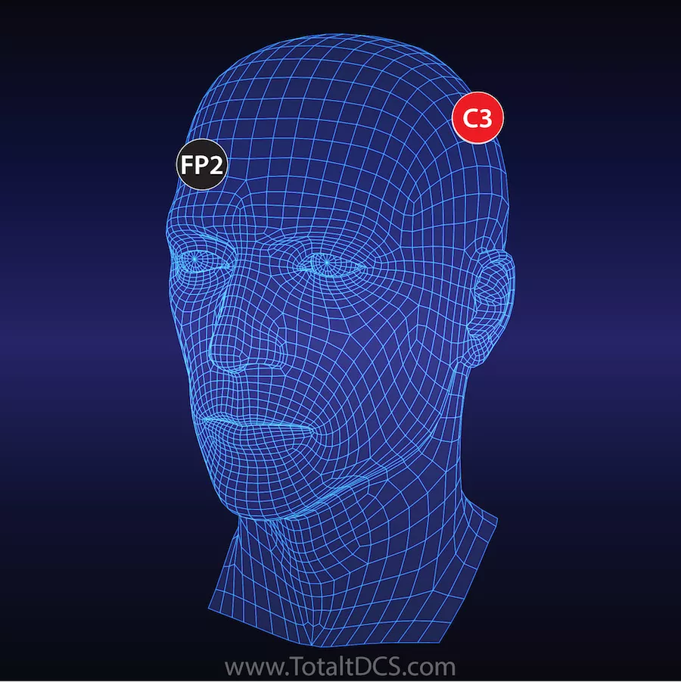
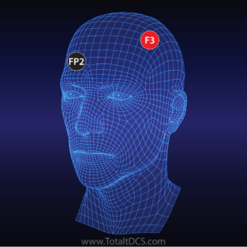
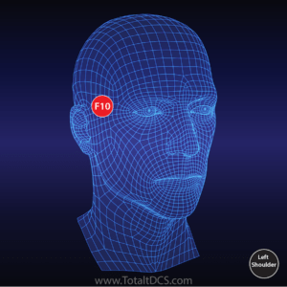
tDCS Montages
Montages are the position of electrodes
Different montages for desired treatments
Reduces chronic pain
Treating depression and anxiety
Accelerated learning

Slide 8
Problem and Need Statement

Slide 9
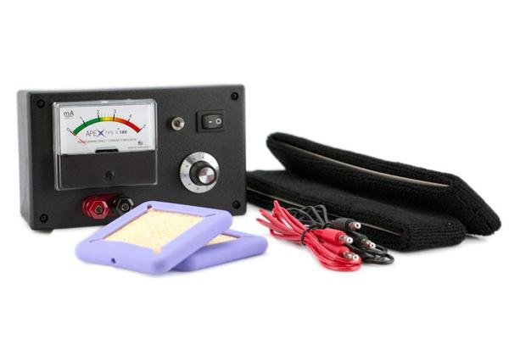
Current Problem
Most devices in the market are expensive ($30 - $400)
Extra cost for more features
Requires prior set up and is hard to use
Incorrect electrode placement can cause adverse effects
Bulky and not disposable
https://caputron.com/products/apex-type-a-tdcs-device?variant=5427100024894
Notes:
Eric

Slide 10
Need Statement
To find a way to make a low cost, easy to use tDCS device that can be disposed after a single dose (20~40 minutes).
Notes:
Eric

Slide 11
Prior Art
Notes:
Rad

Slide 12
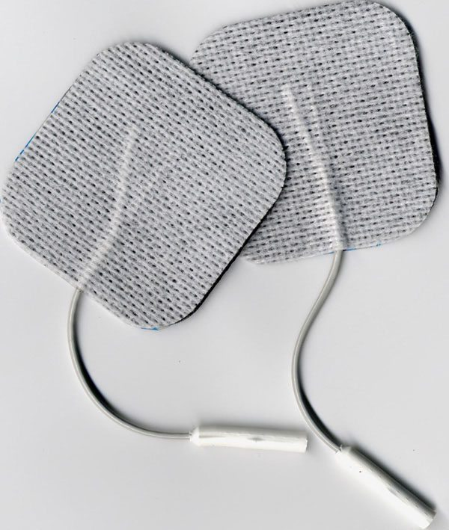
Types of Electrodes - Adhesive Electrode
Cheapest type
Easy to prepare
The conductive material could be carbon.
This type of electrode is designed for direct skin contact for montages including the forehead, or for bald individuals.
The Brain Stimulator tDCS Devices. Choosing The Right Electrodes for tDCS. Retrieved Oct. 22. 2018, from https://thebrainstimulator.net/choosing-electrodes/
Notes:
RAD

Slide 13
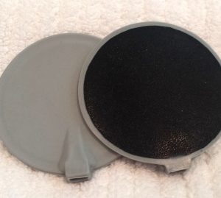
Types of Electrodes - Carbon Electrode
A little more expensive than adhesive type
Harder to prepare
- gel application
- strap to hold the position
The conductive material is carbon.
The Brain Stimulator tDCS Devices. Choosing The Right Electrodes for tDCS. Retrieved Oct. 22. 2018, from https://thebrainstimulator.net/choosing-electrodes/
Notes:
RAD

Slide 14
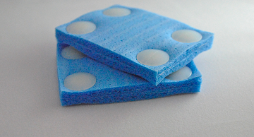
Types of Electrodes - Sponge Electrode
Sponge material to conduct electric current.
Allows current flow on the hair.
Requires a conductive rubber insert that is connected to the device
http://soterixmedical.com/research/1x1/accessories/1x1-easypad
Notes:
RAD

Slide 15
Adhesive Electrode
Carbon Electrode
Sponge Electrode
Cheapest type
Easy to prepare
The conductive material could be carbon.
This type of electrode is designed for direct skin contact for montages including the forehead, or for bald individuals.
Most expensive type of electrode
Harder to prepare
- highest impedance
- gel application
- strap to hold the position
- the conductive material is carbon.
Sponge material to conduct electric current.
Allows current flow on the hair.
Requires a conductive rubber insert that is connected to the device
Notes:
Eric

Slide 16
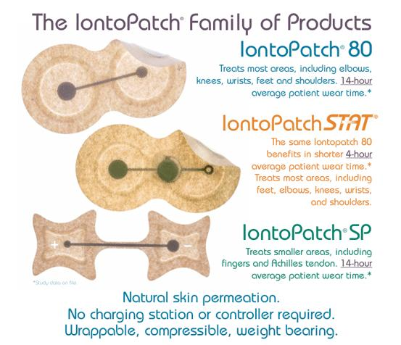
Iontophoresis
Notably Iontophoresis devices like the IontoPatch® present a noteworthy solution to the problem of applying electric current to human skin.
This device uses a small battery to provide a unregulated but relatively constant voltage on the skin to deliver drugs transdermally.
Others examples are- Body med, Active tek and I-Bresis patch.
http://www.iontopatch.com/device.html?fbclid=IwAR06i6e6AbVL3-DXtS2AmJJ1UWTT3mbXqUSO0zvm7ziTf7nfbctIovuJ38I

Slide 17
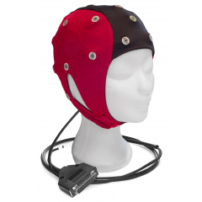
EEG Electrode Locator Headgear
Portable EEG Electrode Locator Headgear, includes an elastic stretchable cap that is connected to EEG electrode locators on the inside [1].
The EEG electrode locators are connected to straps that can be repositioned depending on the areas that are targeted.
The device also comes with an optional plunger assembly that can be used to part the hair for preparation for electrode placement.
[1] Levendowski, Daniel, et al. Portable EEG Electrode Locator Headgear. Patent No. US20020029005A1. 7 Mar. 2002.
https://bio-medical.com/accessories/eeg-caps.html
Notes:
Discuss pros and cons of this type of headgear when presenting
RAD

Slide 18
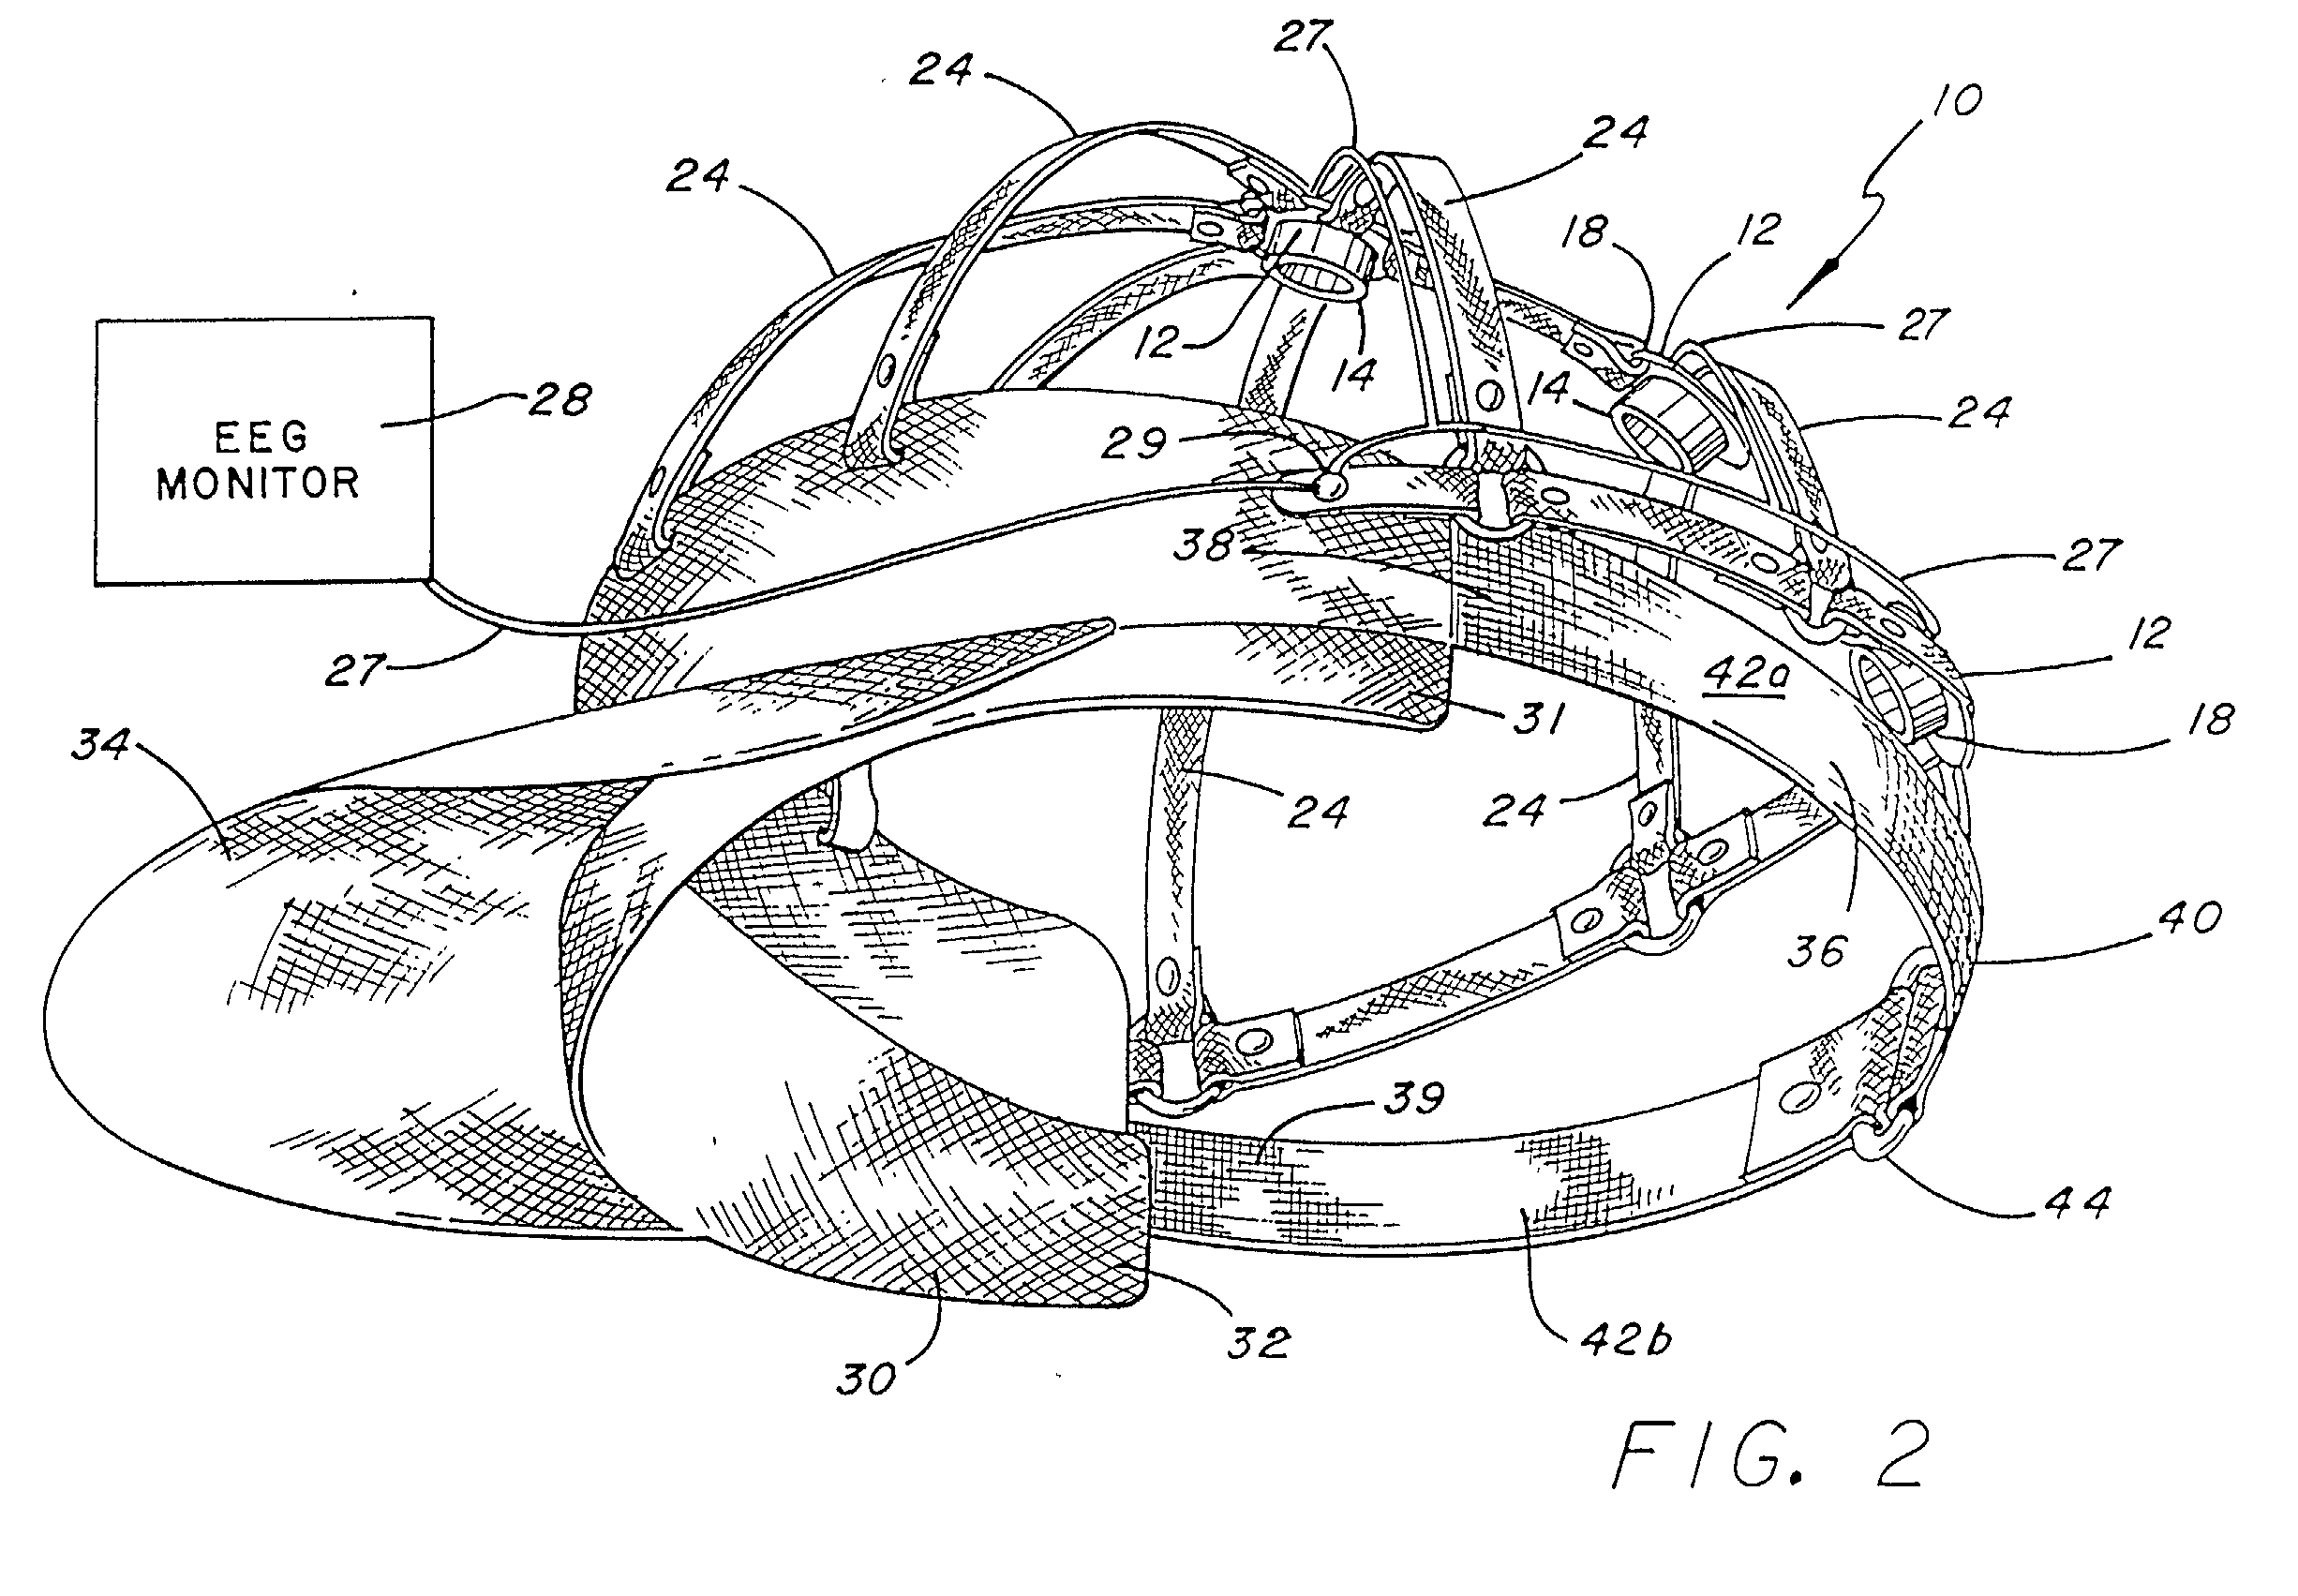
EEG Electrode Locator Headgear Patent
Headgear has adjustable straps to correctly place electrodes
Cons: if the device has too many adjustable options it is less convenient to use and setup
Headgear is collapsible and portable, it can be made of sterilizable plastics [1]
A thin flexible plastic with plastic fasteners could be cheap and disposable
https://patents.google.com/patent/US20020029005A1/en?q=(headgear)&q=(electrodes)&status=APPLICATION&oq=(headgear)+(electrodes)+status:APPLICATION
[1] Levendowski, Daniel, et al. Portable EEG Electrode Locator Headgear. Patent No. US20020029005A1. 7 Mar. 2002.

Slide 19
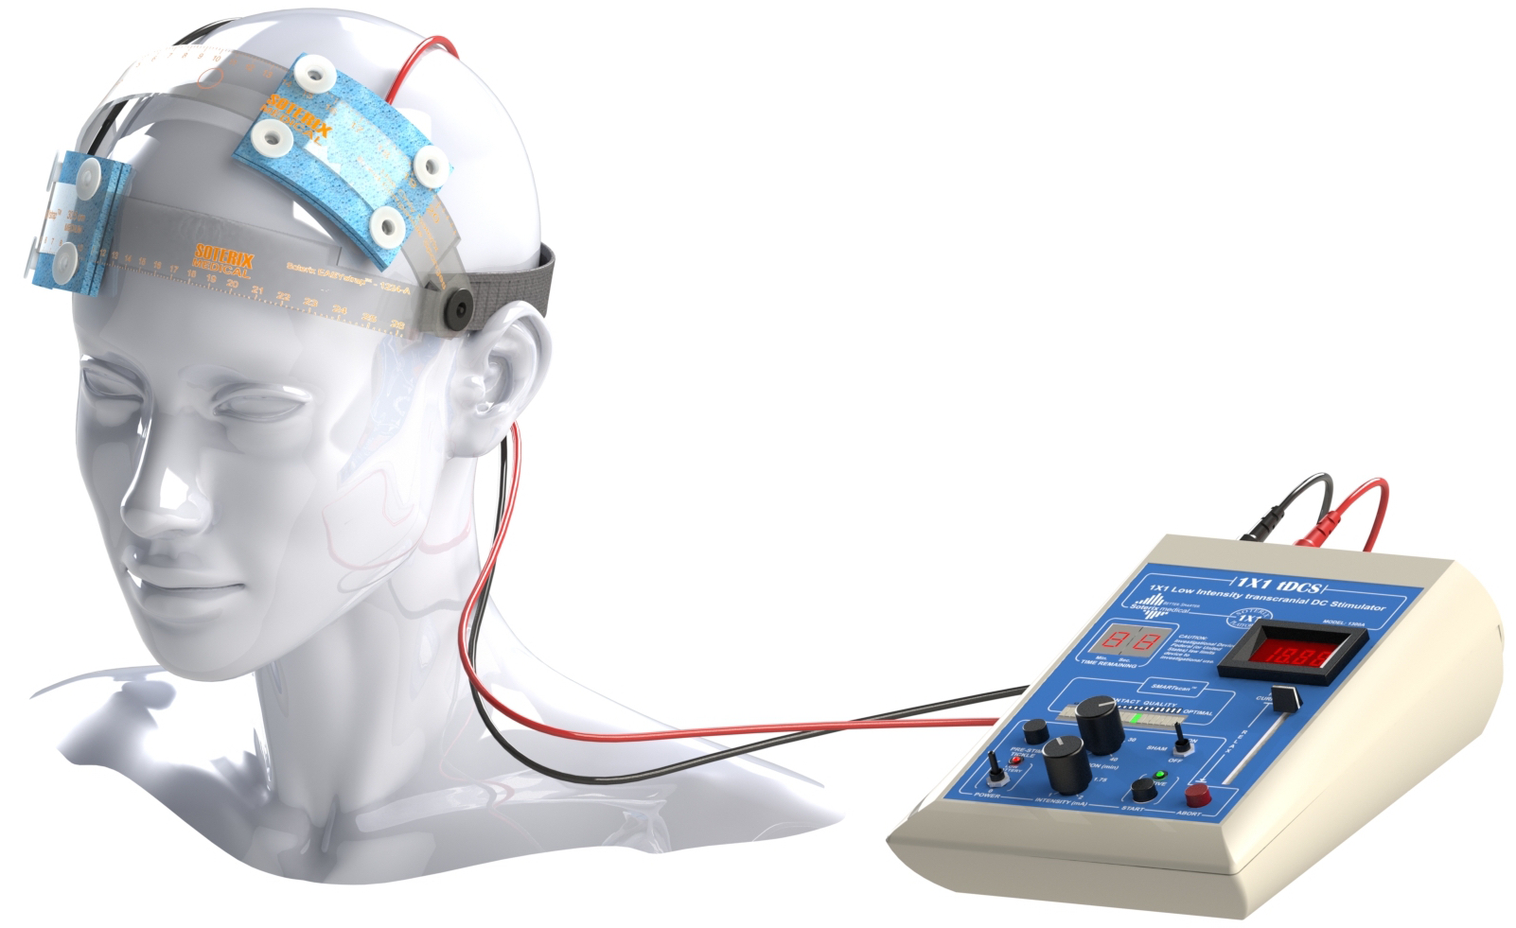
Soterix Medical 1x1 system
This is a complete and modular system for conducting a variety of tDCS montages using the headgear. The circuit it comes with is also fully featured.
Our Project will may try to adopt the simple design of the headgear, but reduce the number of options available for headgear positioning. The circuit that will be used will also be less fully featured.
https://soterixmedical.com/research/1x1

Slide 20
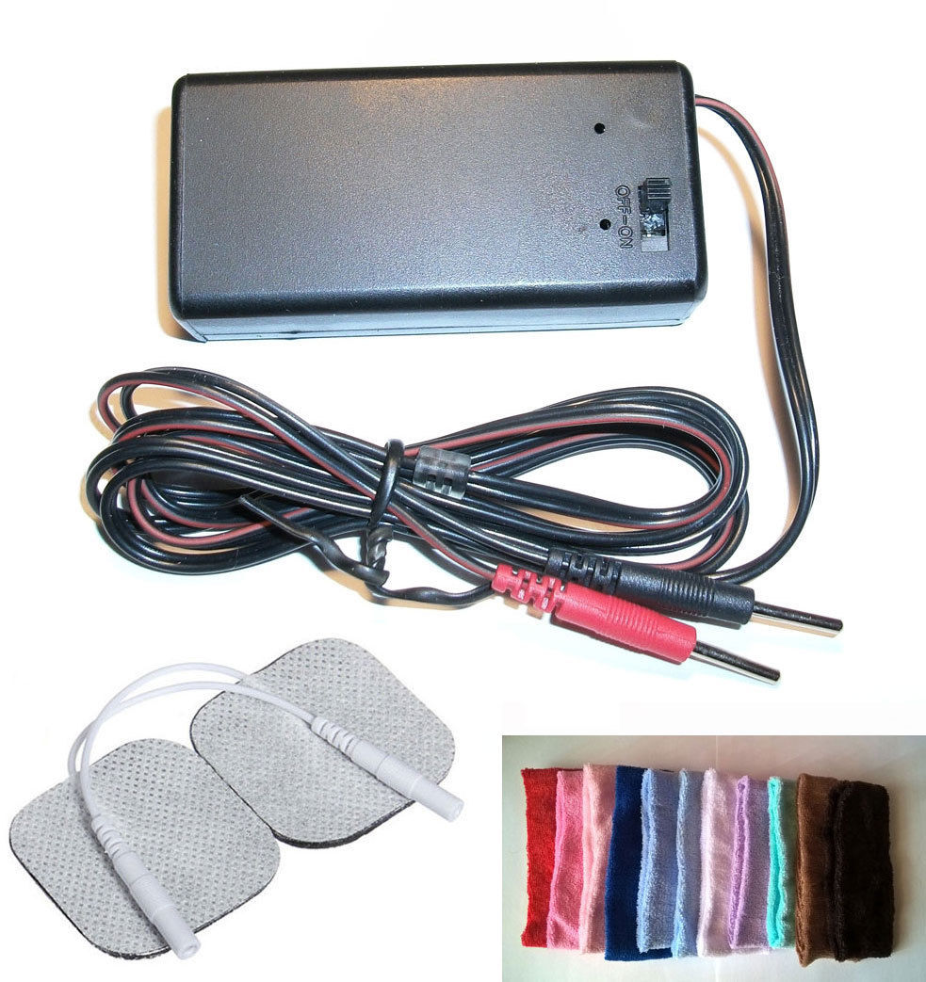
White Market tDCS devices
These devices are similar in formfactor and design as the Soterix system.
Some notable differences are in cost (typically around 30 dollars) and the fact that there are much fewer features.
These devices are made in china, the quality control is probably not trustworthy and they are not sold under a specific company.
https://www.ebay.com/itm/4mA-Transcranial-Direct-Current-Stimulation-TDCS-DIY-ELECTRODES-HEADBAND/292758679611?hash=item4429c6f03b:g:CaEAAOSwa3BZ~2h1:rk:9:pf:0

Slide 21
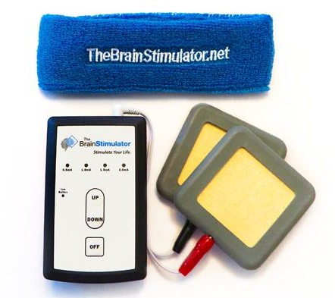
The Brain Stimulator v3.0:
The Brain Stimulator v3.0 is an example of a portable tDCS.
The device features a push buttons which allow the user to increase and decrease the current flow, as well as shut off the device at any time.
The precision components and streamlined circuitry allows the device to operate at the highest 2 milliamp setting for over 90 hours.
It has a replaceable battery and has a 30-minute “set & forget” session timer.
Figure 7: The Brain Stimulator v3.0

Slide 22
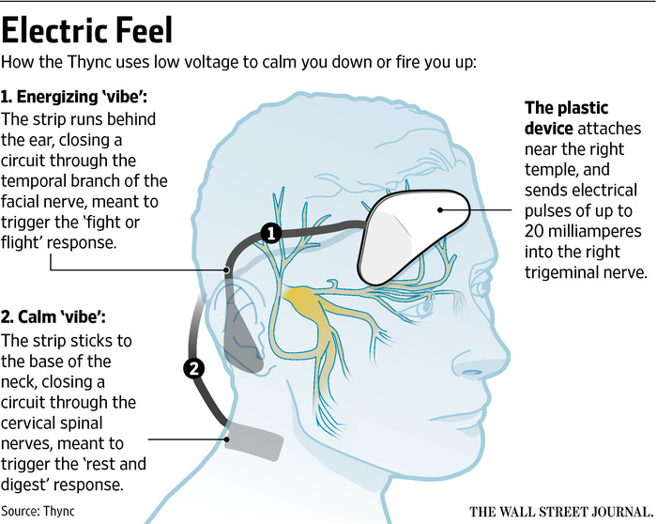
Thync Device
Thync Device is one of the self-usable portable brain stimulation devices in market currently.
Thync doesn’t directly target the brain.
The triangular module applies pulsed electrical currents to the electrodes attached to it, targeting nerves on the face.
Thync claims to have two effects – or “vibes”, calming or energizing
Figure 6: Thync Device

Slide 23
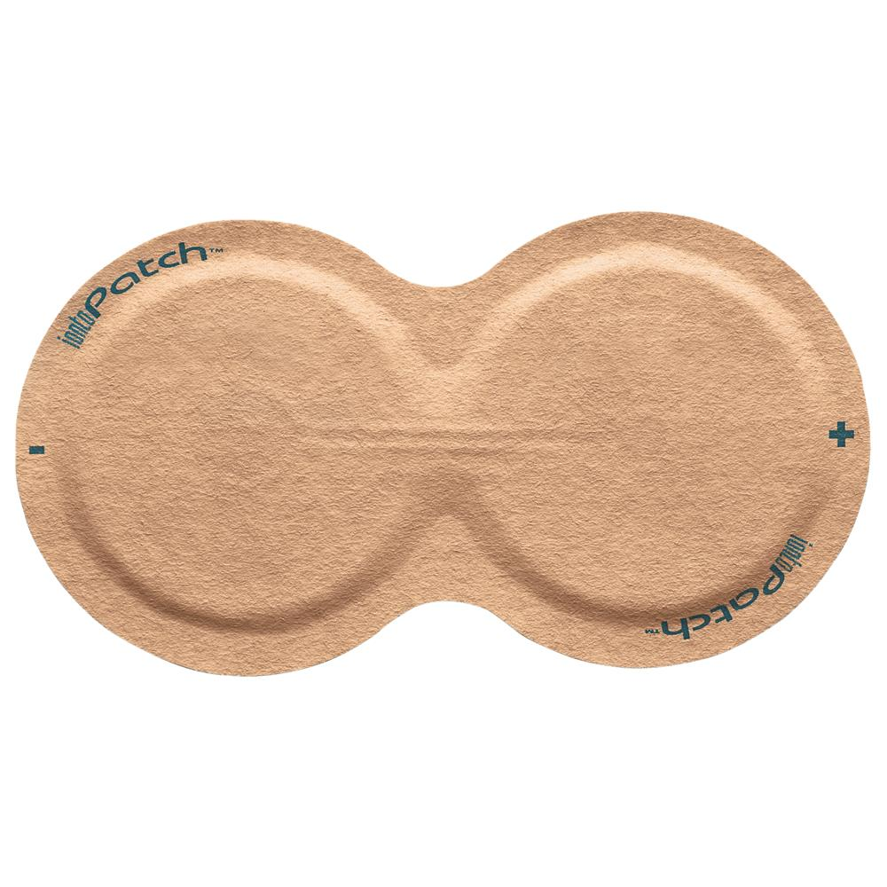
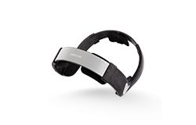
Name / criteria | Iontopatch 80 | Brain Stimulator V3 | Thync | Soterix Medical 1 X 1 | PlatoWork | White market tDCS
Price | $57 per 6 | $130 | $250 | N/A | $450 | $30
Max Current | 0.09 mA | 2 mA | N/A | 2 mA | 2 mA | 1 mA
Auto Ramp up/down | ✘ | ✔️ | ✔️ | ✔️ | ✔️ | ✘
Timer | ✘ | ✔️ | ✔️ | ✔️ | ✔️ | ✘
WaveForms | DC | DC | Pulse | DC | DC | DC
FDA-Cleared | ✘ | ✘ | ✔️ | ✘ | ✘ | ✘
Session Duration | 14 hours | 30 Minutes | 20 minutes | 40 minutes | 15 minutes | N/A

Slide 24
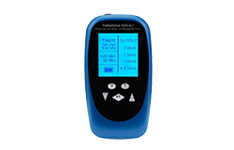
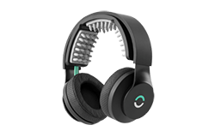
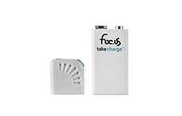
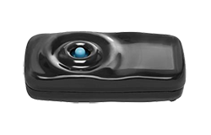
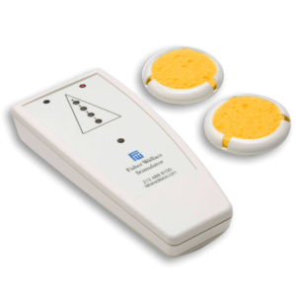
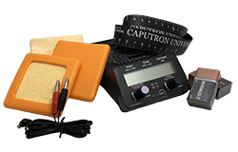
Name/ criterial | Activadose tDCS Device | Focus V3 | Brain Driver | Focus Go flow 4 | Halo | Fisher Wallace Stimulator (CES)
Price | $324.99 | $374.99 | $129.99 | $244 | $499 | $699
Max Current | 4 mA / 2 mA | 2 mA | 2 mA | 4 mA | 2 mA | 4 mA
Auto Ramp up/down | ✔️ | ✔️ | ✔️ | ✔️ | ✔️ | N/A
Timer | ✔️ | ✔️ | ✔️ | ✔️ | ✔️ | ✔️
WaveForms | DC | DC, AC, RN, Pulse, Ripple | DC | DC, soDC | DC | AC, Pulse
FDA-Cleared | ✔️ | ✘ | ✘ | ✘ | ✘ | ✔️
Duration | 40 minutes | 40 minutes | 20 / 30 minutes | 35 minutes | 20 minutes | 20 minutes

Slide 25
Name / criteria | Fisher Wallace Stimulator (CES) | Brain Stimulator V3 | Thync | Soterix Medical 1 X 1 | PlatoWork | Halo | Iontopatch 80
Price | $699 | $130 | $250 | N/A | $450 | $499 | $57 per 6
Max Current | 4 mA | 2 mA | N/A | 2 mA | 2 mA | 2 mA | 0.09 mA
Auto Ramp up/down | N/A | ✔️ | ✔️ | ✔️ | ✔️ | ✔️ | ✘
Timer | ✔️ | ✔️ | ✔️ | ✔️ | ✔️ | ✔️ | ✘
WaveForms | AC, Pulse | DC | Pulse | DC | DC | DC | DC
FDA-Cleared | ✔️ | ✘ | ✔️ | ✘ | ✘ | ✘ | ✘
Duration | 20 minutes | 30 Minutes | 20 minutes | 40 minutes | 15 minutes | 20 minutes | 14 hours

Slide 26
Limitations
Device | Limitations
EEG Electrode Locator Headgear | The device needs a little more work for people with hair. Requires the application of saline before use.
Iontophoresis | Uncertainty of constant voltage and output current. Also requires application of saline before use.
Soterix Medical 1x1 device | The device is expensive and not disposable.
Thync Device | The device is expensive and not disposable.
White Market tDCS devices | They are not disposable, not a lot of features quality is not trustworthy.
The Brain Stimulator v3.0 | Even though the device is relatively cheap, it requires a bit expertise to set up which is prone to mistake by an individual.
Table 1: limitations of prior art
Notes:
David

Slide 27
Intellectual Property Claims

Slide 28
Intellectual Property Claims
Device will be disposable
Device will be easy to use
Patient should be able to self administer the medication
Device will come in easy to open packaging
It will be ready to use and pre assembled inside packaging unlike existing products
Headgear should easy to put on
Device should output a steady current of 4 mA or less depending on the type of device used
The device should be usable for single 30-45 minute dose, then safely deactivated
Notes:
David

Slide 29
Project Specifications

Slide 30
Project Design Specification
Parameter | Value
Electrode size | 0.8 A/m² current density must be maintained. So electrode pads should be larger than 25 cm^2 for 2 milliamp current [1]
Current | 2 mA - 4 mA (safety threshold) [2]
Voltage requirement | 20 V - 43 V [4]
Duration | 30 - 45 minutes [2]
Dosage | Single dose
Headgear circumference | Around 57.2 cm [3] (elastic material)
Weight | Less than 1 lb
Price | 20 USD
Ramp up/Ramp down | 1 mA for 30 seconds
Brunoni AR, Nitsche MA, Bolognini N, et al. Clinical research with transcranial direct current stimulation (tDCS): challenges and future directions. Brain Stimul. 2011;5(3):175-195.
Thair H, Holloway AL, Newport R and Smith doi: 10.3389/fnins.2017.00641
Neyzi O, Bundak R, Gökçay G, et al. nical Research in Pediatric Endocrinology. 2015;7(4):280-293. doi:10.4274/jcrpe.2183.
DIY | DIY Tdcs | Page 2." Diytdcs.com. N. p., 2015. Web. 15 Oct. 2018.
Notes:
David

Slide 31
Concept Selection Process

Slide 32
Brainstorming map
Power supply
Low cost, ready to use, “disposable” tDCS
disposability
Batteries in series for higher voltage
Wireless power supply (AC)
headgear
Cap headgear
10-20 3v coin cell batteries
2-6 9v battery
Strapped headgear
Circuit design
Charged capacitor buck converter
Pulse current amplifier
electrodes
Premade straps
carbon
Goal 14.5-18.5v
1.5 mA to 2.5 mA
20-43v in market
Sponge
Collapsible headgear
Porous Prong
Constant current amplifier
Use a transistor to regulate
cheap
adhesive
too expensive
User adjustable strap
cheapest but doesn't work for hairy skin
Use an op amp to produce constant current
Use a voltage regulator to regulate
presoaked
Notes:
Rad

Slide 33
Concept 1: strap headgear + transistor circuir + power supply
2 mA
This strap headgear design requires some assembly but it is the most straightforward design
The circuit uses a transistor to manage constant current
Disposable headgear if strap material is cheap
Circuit is one button operation
amperage
Cost is cheap because circuit is built for just one current setting
Cost/disposability
usability
Duration is managed using a 555 timer as with other designs we will design it to turn on on button push
Low cost, Ready to use, Disposable tDCS
duration
Should cost about 10$
Ramp up/down
Performed with additional circuit (op amp integrator)
electrodes
and then turn off in after
40 minutes
30s/1mA
4cm by 4cm
Sponge electrode for comfort
Notes:
Rad

Slide 34
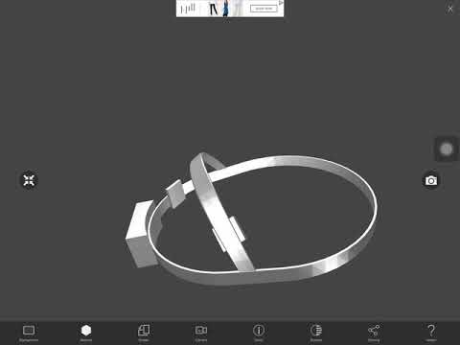
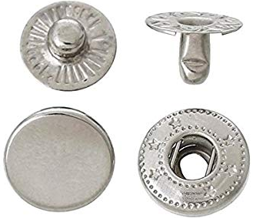
Concept 1
Circuit provides a constant current DC supply using a BJT transistor circuit.
The power source needs to be high voltage
Wires are attached using conductive clothing snaps to the sponge electrodes
A timing circuit will be used consisting of a 555 timer
Ramp up and ramp down functionality will be provided using an integrator
Strap material will be semi flexible
Dry electrodes snap onto the headgear
Notes:
Rad

Slide 35
Concept 2: Cap headgear + DC current
Headgear
Cap headgear
Cost/disposability
Disposable
Sponge electrodes will be already attached to the cap. The electrodes will have small opening where saline can be poured.
Less than $20
DC current
Low cost, ready to use, “disposable” tDCS
Circuit
Duration
30 minutes
2 mA
Circuit is one button operation
usability
Sponged electrodes already attached
Timing can be managed with a microcontroller
Ramp up/down and timer
This cap headgear design requires no assembly
ATtiny or 8 bit microcontroller

Slide 36
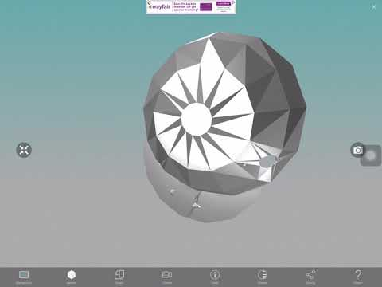
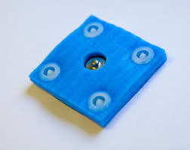
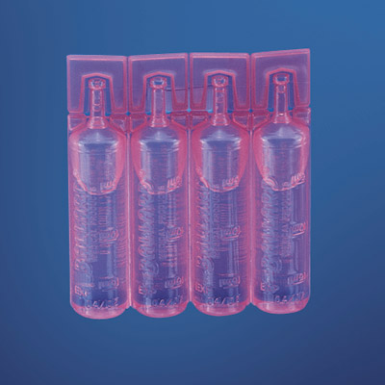
Hat with 2 Electrodes (disposable).
Wires are attached to the conductive “snap on” pins.
Circuit box
DC current
Uses atmega chip
Electrode are pre snapped on the pin.
Small opening for saline
2 or 3 packs of prepackaged saline
"Ballard Unit Dose Saline 0.9% Sodium Chloride Solution, 15Ml Vial, 144/Cs | Medex Supply." Medexsupply.com. N. p., 2018. Web. 2 Dec. 2018.

Slide 37
Components | Unit Price | quantity | Price
Hat | 88 cents in bulk | 1 | 0.88 USD
Circuit Box | 1.50 USD | 1 | 1.50 USD
microcontroller | 44 cents | 1 | 44 cents
Power source
Wires
Saline vial | $0.50 (15 mL) | 3 | 1.50 USD
Sponge electrode | $4 | 2 | 8 USD
Snap on pins
Notes:
https://www.amazon.com/d/Car-Amplifier-Battery-Wiring-Terminals/Pangda-Pack-Battery-Clip-Connector/B06ZYWFPS1/ref=sr_1_2_sspa?s=automotive&ie=UTF8&qid=1546448087&sr=1-2-spons&keywords=9v+battery+connectors&psc=1

Slide 38
Concept 3: strap headgear + coin cell batteries + sponge electrode
expensive
Snap sponge
Pre salinated
Works on the hairline
Fixed to position
electrode
disposable
Snap strap
duration
30 mins
Low cost, Ready to use, Disposable tDCS
Depression/anxiety
montages
headgear
circuit
Constant current
2 mA
Ramp up/down
3 V coin cell batteries
Power consumption
User
friendly
Not disposable
In series
Electrode on plastic headgear
One button stimulation
Limited settings

Slide 39
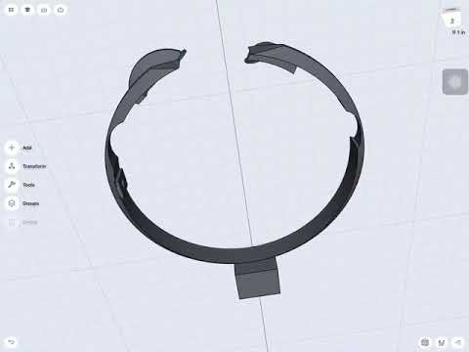

Slide 40
Concept 4: Cap Headgear + Prong electrodes + 9V battery
Headgear with electrodes fully disposable
Cost around $20
Prong electrode has to be customly manufactured
Increase cost
Partially Disposable
Cap is low cost
Cost
Circuit is low cost
Circuit reusable
Disposability
10 - 40 minutes
Low cost, ready to use, “disposable” tDCS
Duration
Ramp up/down
Circuit
Attach circuit by snap to start stimulation
Circuit separate from cap
Electrode
Usability
Constant current
Prong electrode
Electrode comes set up in the correct montage
Electrodes require soaking with tap water
Pre-salted just add water to make saline solution

Slide 41
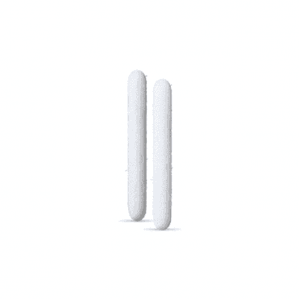
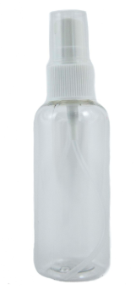
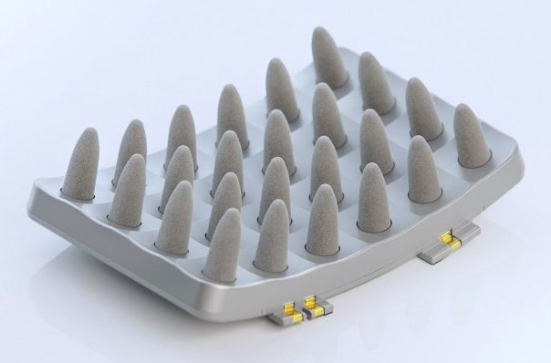
Hat with two electrodes on the depression montage
Electrode comes unattached
Attach via snap
Dry foam prong electrode
Pre-salted
Spray bottle
Circuit Box
DC
Op amp

Slide 42
Selection Matrix
Criteria | weight | Concept 1 | Concept 2 | Concept 3 | Concept 4 | Brain stimulator v3.0
Ease of use | 3 | 1 | 1 | 1 | 1 | 0
Low Cost | 4 | 1 | 1 | 1 | 1 | 0
Environmental effect | 1 | 0 | 0 | 0 | 0 | 0
Disposability | 4 | 1 | 1 | 1 | 1 | 0
Ergonomics | 3 | -1 | 1 | -1 | -1 | 0
Waveform | 3 | 1 | 1 | 1 | 1 | 0
Weighted sum |  | 11 | 14 | 11 | 11 | :0

Slide 43
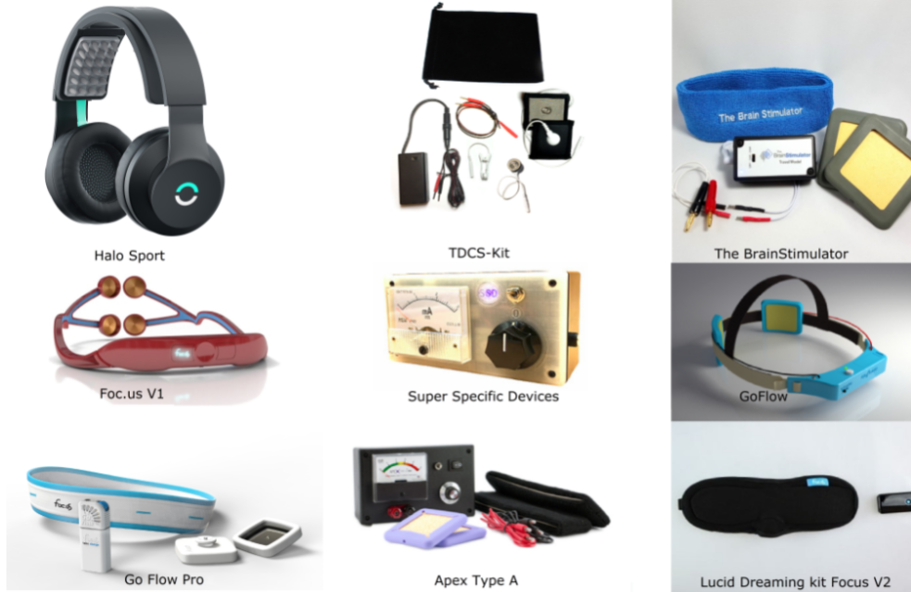
Selection Matrix: Concept 2

Slide 44
References
Churchland, Patricia Smith. Neurophilosophy: Toward a unified science of the mind-brain. MIT press, 1989.
Reinhart, Robert MG, et al. "Using transcranial direct-current stimulation (tDCS) to understand cognitive processing." Attention, Perception, & Psychophysics 79.1 (2017): 3-23.
Mondino, Marine, et al. "Transcranial direct current stimulation for the treatment of refractory symptoms of schizophrenia. Current evidence and future directions." Current pharmaceutical design 21.23 (2015): 3373-3383.
Shahbabaie A, Hatami J, Farhoudian A, Ekhtiari H, Khatibi A, Nitsche MA. Optimizing Electrode Montages of Transcranial Direct Current Stimulation for Attentional Bias Modification in Early Abstinent Methamphetamine Users. Frontiers in Pharmacology. 2018;9:907. doi:10.3389/fphar.2018.00907.
Bachtiar V, Johnstone A, Berrington A, et al. Modulating Regional Motor Cortical Excitability with Noninvasive Brain Stimulation Results in Neurochemical Changes in Bilateral Motor Cortices. The Journal of Neuroscience. 2018;38(33):7327-7336. doi:10.1523/JNEUROSCI.2853-17.2018.
Ciechanski, P., et al. "Effects of transcranial direct‐current stimulation on laparoscopic surgical skill acquisition." BJS Open 2.2 (2018): 70-78.
Choe, Jaehoon, et al. "Transcranial direct current stimulation modulates neuronal activity and learning in pilot training." Frontiers in human neuroscience 10 (2016): 34.
Sample, Ian. "US Military Successfully Tests Electrical Brain Stimulation To Enhance Staff Skills." the Guardian. N. p., 2016. Web.15 Oct. 2018.
Manders, Eric. Handboek neurologische communicatiestoornissen. Maklu, 2016.

